Slide 1
Agenda
What is Big data ?
Sources of Big data
Categories of Big data
Characteristics of Big data
Traditional RDBMS vs Hadoop
What is Hadoop ?
History of Hadoop
Hadoop Architecture
Hadoop Core Components
HDFS
MR
Hadoop 1.x architecture
Hadoop 1.x daemons

Slide 2

Sources of Big data in 2020

Slide 3

What is BIGDATA ?

Slide 4
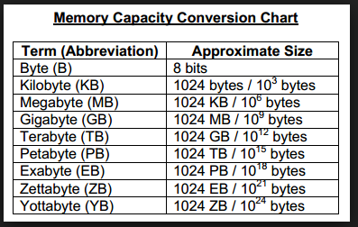
What is BIGDATA ?
'Big Data' is also a data but with a huge size.
'Big Data' is nothing but the huge amount of data which cannot be stored & processed by traditional systems such as RDBMS
It is stated that almost 90% of today's data has been generated in the past few years.

Slide 5
Categories of BIGDATA
Big data could be found in three forms:
Structured
Unstructured
Semi-structured

Slide 6
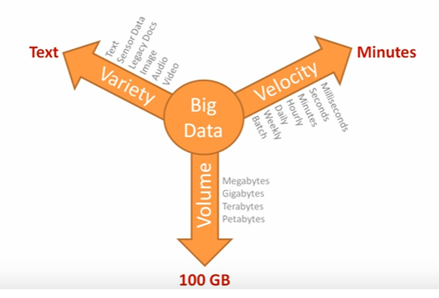
3 V’s / Characteristics of BIGDATA

Slide 7

What is the solution for BIG DATA ?

Slide 8
Traditional RDBMS vs. Hadoop
Storage limit
Varieties
Cost of software
Processing type
Cost of hardware
Source code

Slide 9
History of Hadoop
Doug cutting is the founder of Hadoop
Doug cutting named it as Hadoop after his son’s toy elephant name.
He published below 2 white papers:
Google File System(GFS) in 2003
MapReduce: Simplified Data Processing on Large Clusters in 2004

Slide 10
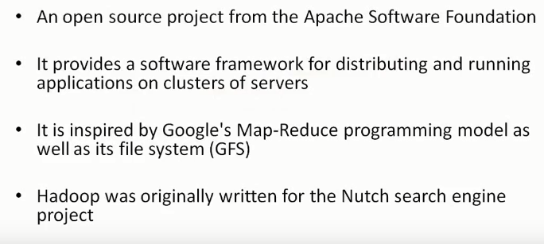
What is Hadoop ?

Slide 11
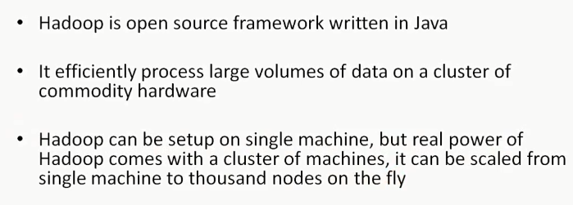
What is Hadoop ?

Slide 12
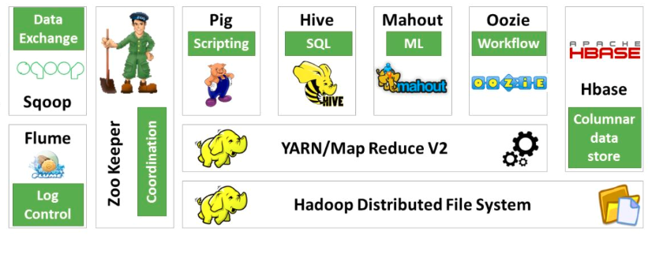
Hadoop ecosystem components

Slide 13

King & Minister Story

Slide 14

King & Minister Story-Sequential Processing

Slide 15

King & Minister Story-Distributed Processing

Slide 16
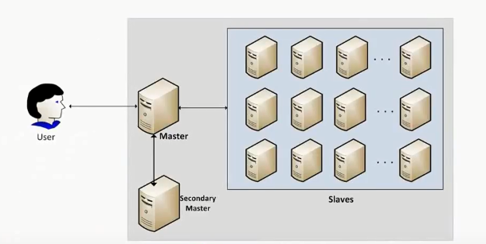
Hadoop Architecture

Slide 17
Hadoop Architecture
Master → Name Node(NN)
Secondary Master → Secondary Name Node(SNN)
Slaves → Data Nodes(DN) / Worker Nodes(WN)

Slide 18
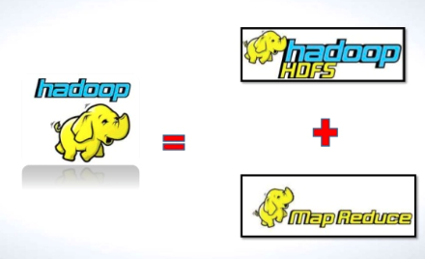
Hadoop Core Components

Slide 19
HDFS
HDFS is a highly fault tolerant , distributed file system for data storage
HDFS stores multiple copies of data on different Data Nodes(DN)/Worker Nodes(WN)
A file is split up into blocks and stored across multiple Data Nodes(DN) by maintaining multiple copies of each block
Block size = 64 MB by default in Hadoop 1.X
Block size = 128 MB by default in Hadoop 2.X
Hadoop cluster typically has a single Name Node(NN) and number of Data Nodes(DN) to form the HDFS Cluster

Slide 20
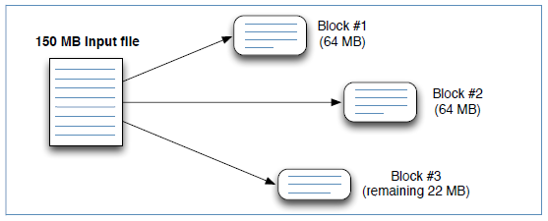
HDFS Blocks
When a file is added to HDFS, it is split into blocks.
Every block is replicated 3 times by default.
Default block size is 64 MB (configurable) (Hadoop 1x), 128 MB (Hadoop 2x).

Slide 21
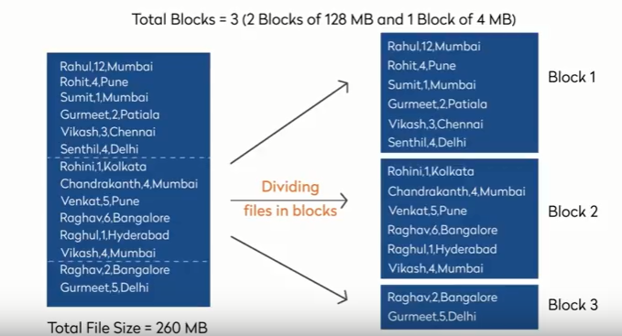
Creation of blocks in HDFS

Slide 22
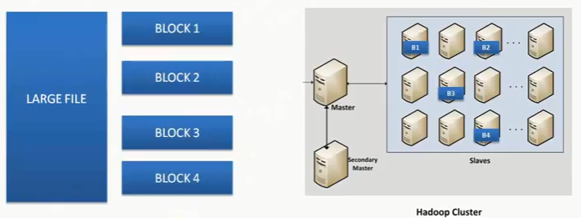
HDFS-Fault Tolerance

Slide 23
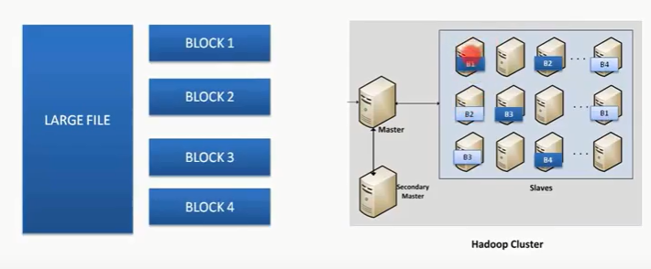
HDFS-Fault Tolerance

Slide 24
What is Map-Reduce ?
Map-Reduce is a programming model designed for processing large volumes of data in parallel by dividing the work into a set of independent tasks
Map-Reduce is a paradigm for distributed processing of large data set over a cluster of nodes

Slide 25
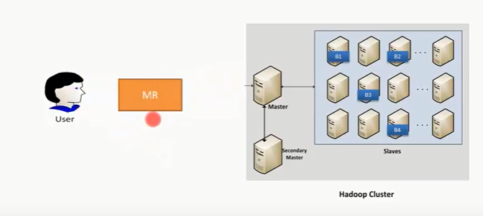
What is Map-Reduce ?

Slide 26
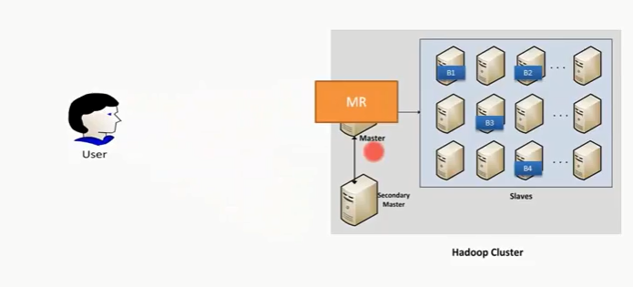
What is Map-Reduce ?

Slide 27
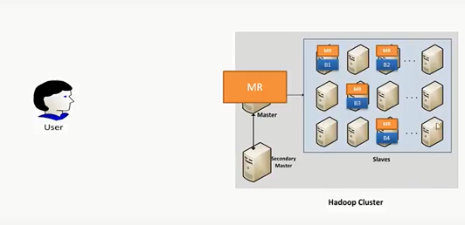
What is Map-Reduce ?

Slide 28
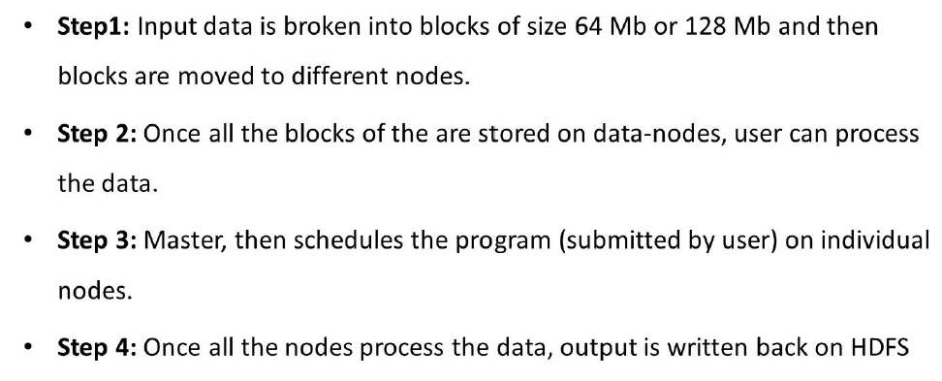
How Hadoop Works ?

Slide 29
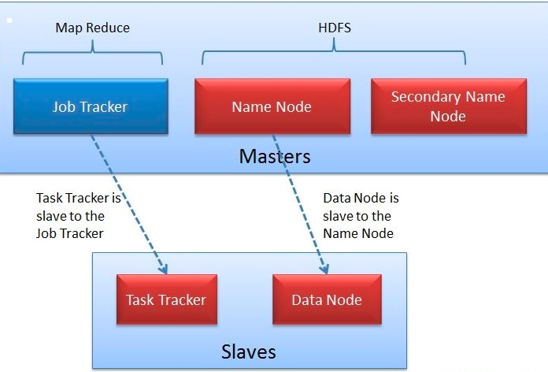
Daemons in Hadoop 1.x

Slide 30
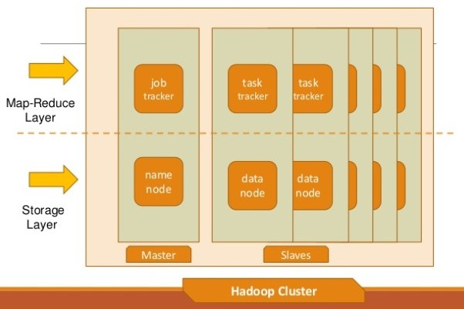
Daemons in Hadoop 1.x

Slide 31
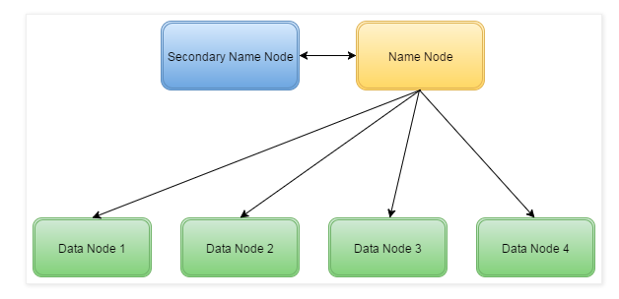
Hadoop 1.x architecture

Slide 32
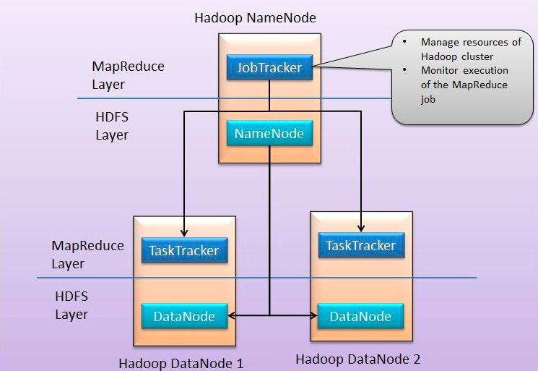
Hadoop 1.x architecture

Slide 33
Hadoop 1.x Daemons
HDFS:
Name Node(NN) → Master
Secondary Name Node (SNN)
Data Node(DN) / Worker Node(WN) → Slave
Map Reduce:
Job Tracker(JT) → Master
Task Tracker(TT) →Slave

Slide 34
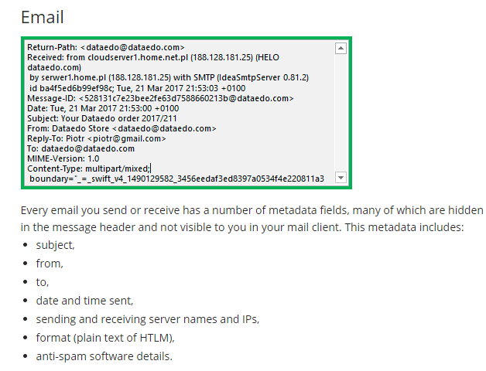
Metadata-examples

Slide 35
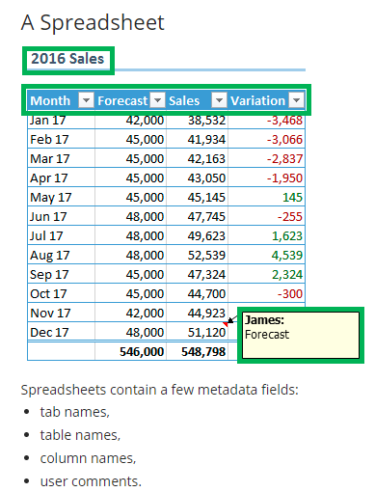
Metadata-examples

Slide 36
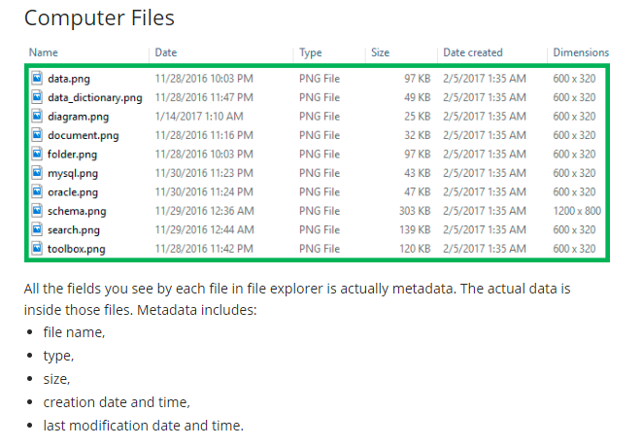
Metadata-examples

Slide 37
Name Node(NN)
It is the master node and stores the file system metadata.
The NameNode stores all metadata.
Information about file locations in HDFS.
Information about file ownership.
Information about file permissions.
Information about file timestamp.
Information about file size.
Information about file replication.
Names of the individual blocks.
Locations of the blocks.

Slide 38
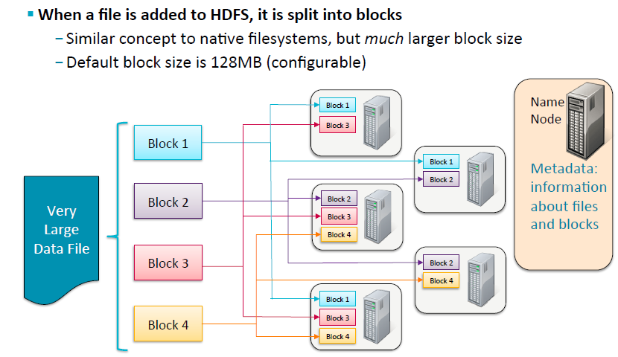
Name Node(NN)

Slide 39
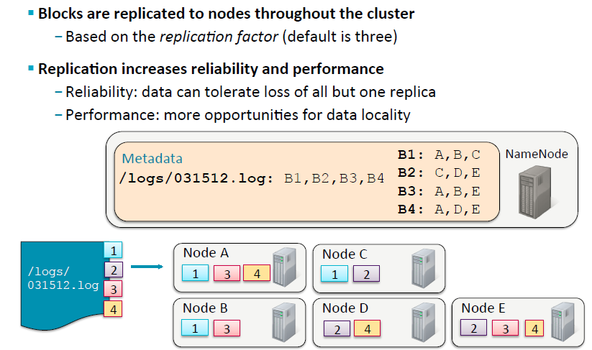
Name Node(NN)

Slide 40
Name Node(NN)
Metadata is stored on disk and read when the NameNode starts up
Filename is fsimage
Changes to the metadata are made in RAM
Changes are also written to a log file on disk called edits
Full details later
First Point of contact for all HDFS operations
NN is called Single Point Of Failure(SPOF)

Slide 41
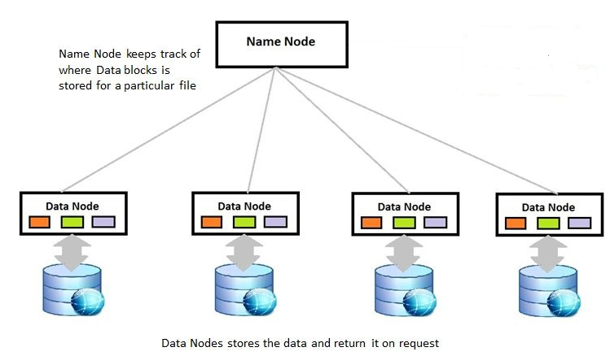
Name Node(NN)

Slide 42
Data Node(DN)
Data node is the ‘Slave’ in HDFS Layer
DN stores the actual data in the form of blocks based on the instructions from NN
DN will send a heart-beat signal to the NN every 3 seconds which means the DN is alive and working fine
So the DN and NN communicate via the “heart-beat mechanism”

Slide 43
Secondary Name Node(SNN)
The Secondary Name Node is not-a failover Name Node!
Retrieve fsimage and edits from Name node and perform checkpoint on regular intervals.
FSIMAGE+EDITS = NEW FSIMAGE = CHECKPOINT

Slide 44
Job Tracker(JT)
Only one instance of this process runs on a master node same as Name Node
Any MapReduce job is submitted to Job Tracker first
Job Tracker checks for the location various file blocks used in MapReduce processing
Then it initiates the separate tasks on various Data Nodes(where blocks are present) by communicating with Task Tracker Daemons

Slide 45
Task Tracker(TT)
This process has multiple instances running on the slave nodes(typically runs on the slave nodes where Data Node process is running)
It receives the job information from Job Tracker daemon and initiates a task on that slave node
In most of the cases, Task Tracker initiates the task on the same node where there physical data block is present
Same as Data Node daemon, this process also periodically sends heart beats to Job Tracker to make Job Tracker aware that slave process is running

Slide 46
Summary of today’s session
HDFS:
Name Node(NN) → Master
Secondary Name Node (SNN)
Data Node(DN) / Worker Node(WN) → Slave
Map Reduce:
Job Tracker(JT) →Master
Task Tracker(TT) → Slave

Slide 47
Interview Questions
1.Which of the below can be considered as characteristics of bigdata ?
A. Volume
B. Velocity
C. Variety
D. All the above

Slide 48
Interview Questions
2.Hadoop is the solution for bigdata problem.
A.True
B.False
3.Hadoop follows distributed/parallel processing mechanism to process bigdata
A. True
B. False

Slide 49
Interview Questions
4.Which of the below in traditional RDBMS lead to the evolution of hadoop ?
A. Storage limit constraint
B. Parallel Processing
C. Open-Source
D. Cost of the software is free

Slide 50
Interview Questions
5.What is the default block size in Hadoop 2.X ?
A. 64MB
B. 128 MB
C. 256 MB
D. 512 MB

Slide 51
Interview Questions
6. Which is the Master Node in Hadoop ?
A. Name Node(NN)
B. Data Node(DN)
C. Secondary Name Node(SNN)
D. None of the above

Slide 52
Interview Questions
7.Into how many blocks a file of 260 MB will be divided into in Hadoop 2.X ?
A. 1
B. 2
C. 3
D. 4

Slide 53
Interview Questions
8.Which of below can be considered as Worker Nodes(WN) in Hadoop ?
A. Name Node(NN)
B. Data Node(DN)
C. Secondary Name Node(SNN)
D. None of the above

Slide 54
Interview Questions
9.Is Hadoop Fault-Tolerant ?
A.True
B.false
10.Select popular Hadoop distributions from below:
A. Cloudera
B. Horton Works
C. MapR
D. All the above

Slide 55
Assignment for day-1
Download and install all the software that are needed for Hadoop environment
Hint: Refer the other PPT ;-)

Slide 56
Any Questions ???

Slide 57
Thank You!!!

